Slide 1
The Haunted Mansion: A Text Adventure Game
By Declan, Nigel, Ben, Zach

Slide 2
Intro
Meet the Team
Meet the Project
Our Thesis:
Planning, The making of the game, Project Management, Game play.
Lets get into it….

Slide 3
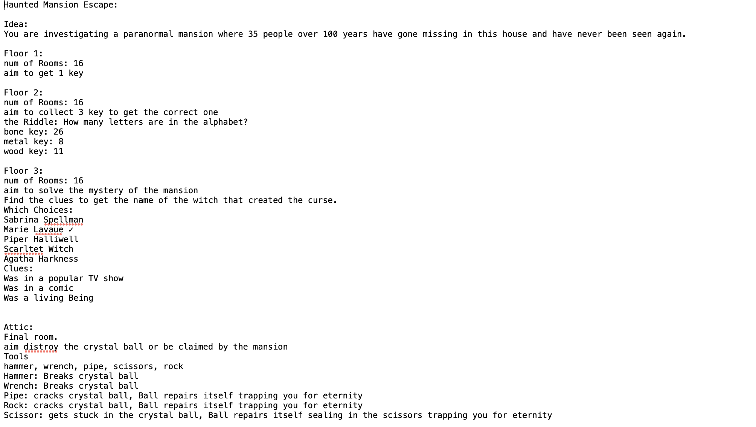
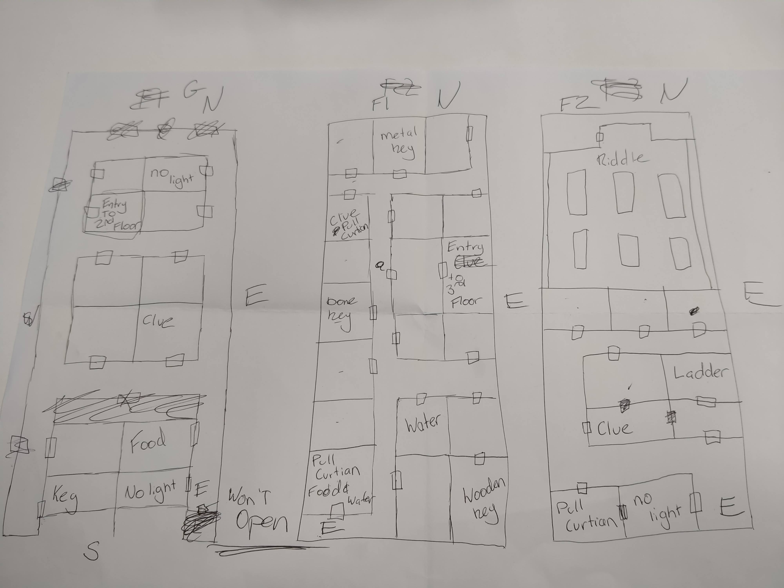
Planning
Idea of the Game
Storyline
Plot
Script of the game

Slide 4
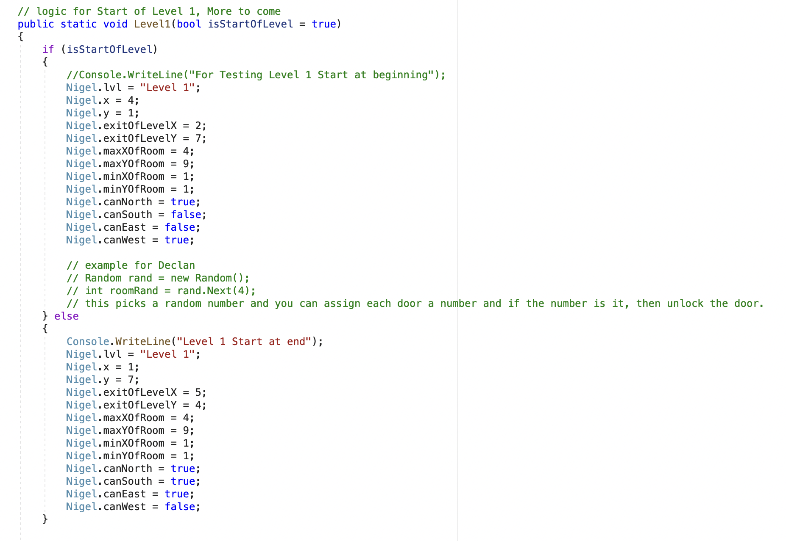
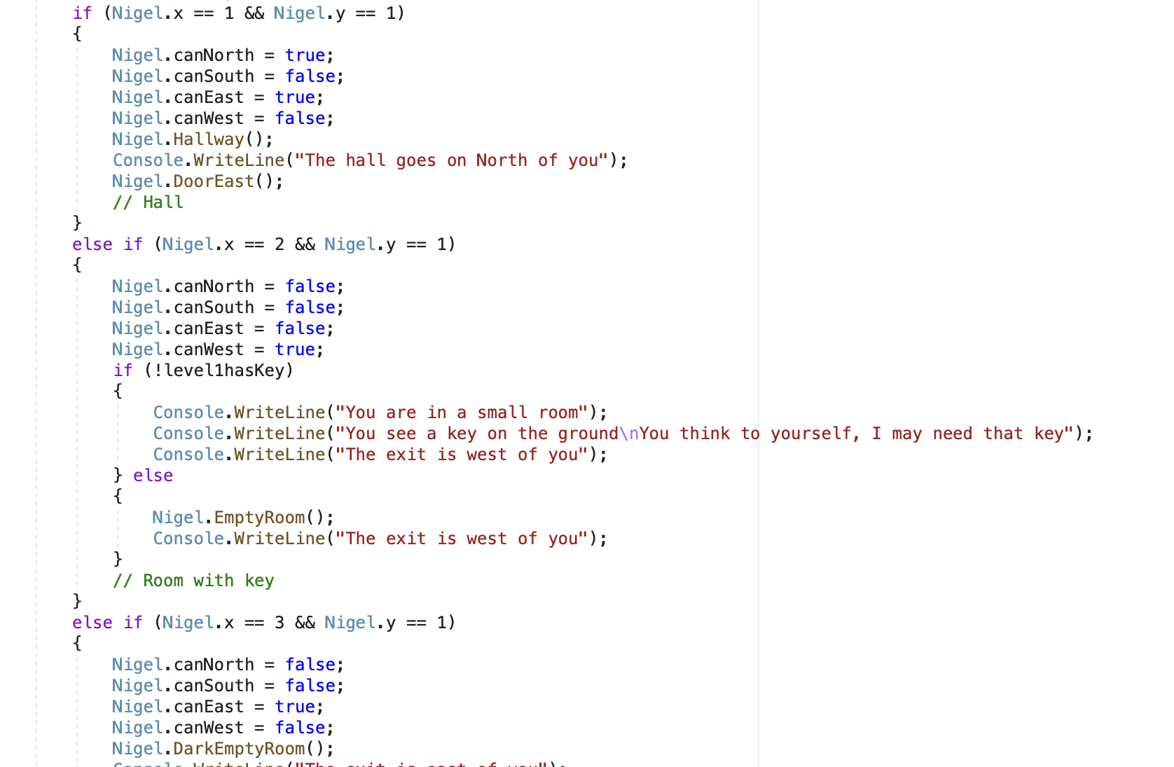
Making of the game
The beginning
Movement System
Keeping similar formats
Problems we faced

Slide 5




Project management
Assessing abilities
Explaining how to use Class files
Using Git and our own Class files
Communication

Slide 6
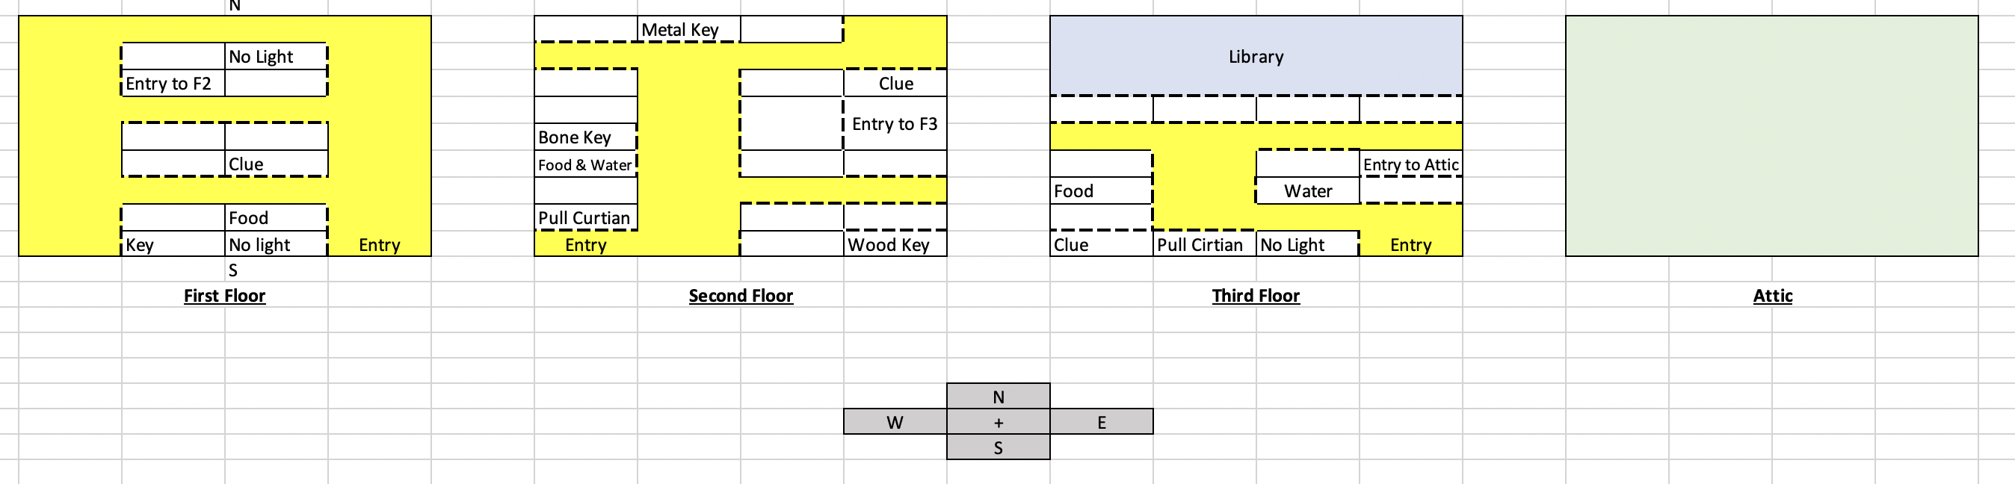
Game Play
Map layout
Gameplay:
Level 1
Level 2
Level 3
Attic

Slide 7
Conclusion
Thanks for listening

